Slide 1
Abstract Data Types (ADTs)
An abstract data type (ADT) is an abstraction of a data structure
An ADT specifies:
Data stored
Operations on the data
Error conditions associated with operations
1

Slide 2
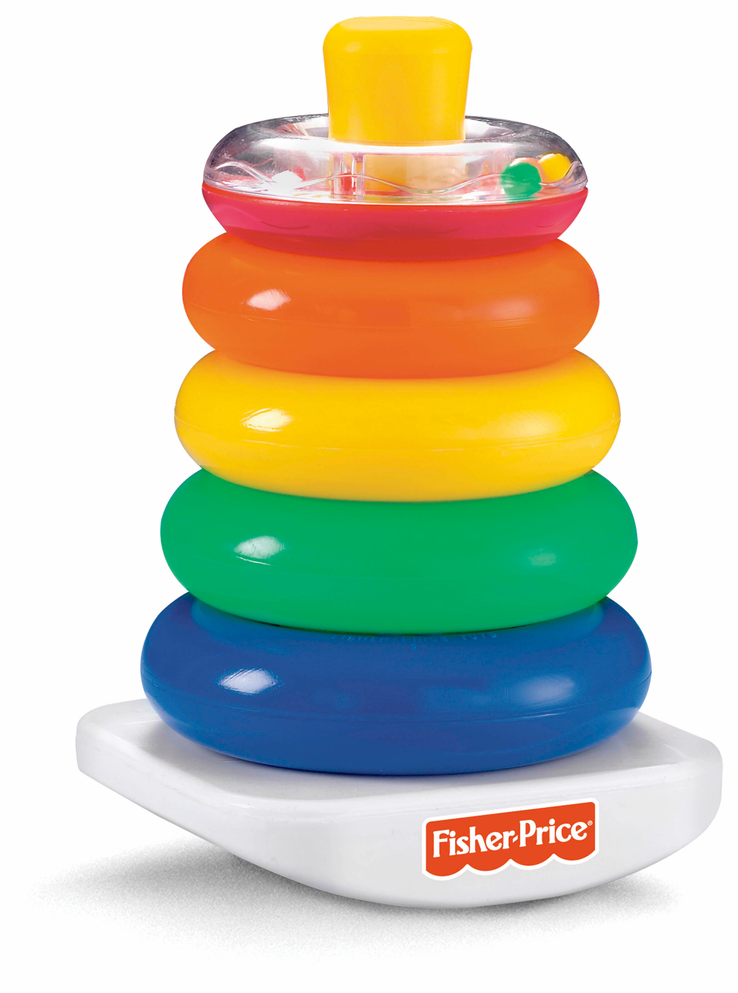
The Stack ADT
push
pop
top
2

Slide 3
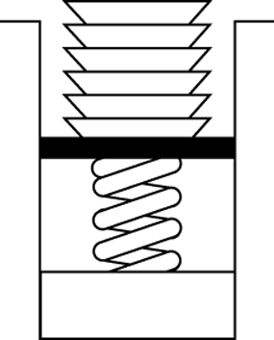
The Stack ADT
The Stack ADT stores arbitrary objects.
Insertions and deletions follow the last-in
first-out (LIFO) scheme.
The last item placed on the stack will
be the first item removed.
(similar to a stack of dishes)
Stack of Dishes
3

Slide 4
ADT Stack Operations
Create an empty stack
Destroy a stack
Determine whether a stack is empty
Add a new item -- push
Remove the item that was added most recently -- pop
Retrieve the item that was added most recently
push
pop
top
Stack
4

Slide 5
ADT Stack Operations(cont.)
Stack()
creates a an empty stack
~Stack()
destroys a stack
isEmpty():boolean
determines whether a stack is empty or not
push(in newItem:StackItemType)
Adds newItem to the top of a stack
pop() throw StackException
topAndPop(out stackTop:StackItemType)
Removes the top of a stack (ie. removes the item that was added most recently
getTop(out stackTop:StackItemType)
Retrieves the top of stack into stackTop
5

Slide 6
Implementations of the ADT Stack
The ADT stack can be implemented using
Array based:
Fixed size (cannot grow and shrink dynamically)
Using a customized linked-list:
The size can match perfectly to the contained data
Push and pop can be a bit slower than above
6

Slide 7
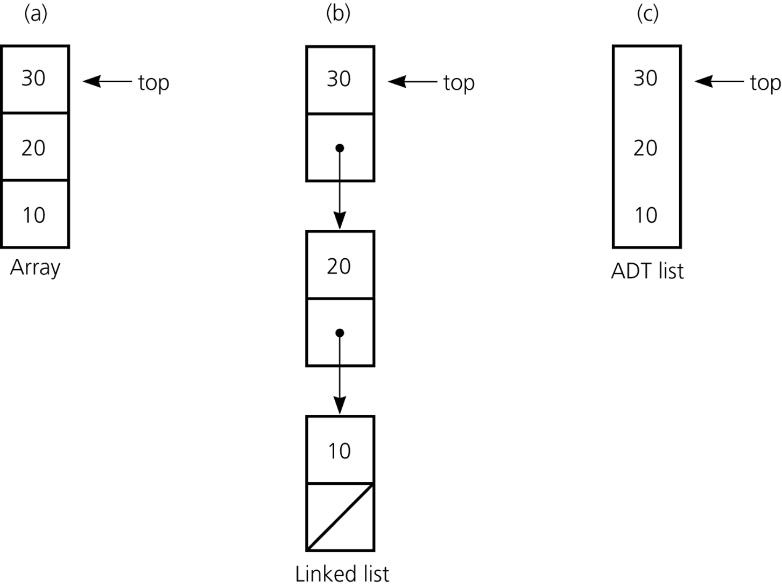
Implementations of the ADT Stack (cont.)
2
1
0
(reuse existing List.h)
(pointer-based)
7

Slide 8
A Simple Stack Application -- Undo sequence in a text editor
Problem: abcd← ←fg ← ➔ abf
// Reads an input line. Enter a character or a backspace character (←)
readAndCorrect(out aStack:Stack) {
?????????????????????????????
}
8

Slide 9
Prefix, Postfix, Infix Notation

Slide 10
Infix Notation
To add A, B, we write
A+B
To multiply A, B, we write
A*B
The operators ('+' and '*') go in between the operands ('A' and 'B')
This is "Infix" notation.

Slide 11
Prefix Notation
Instead of saying "A plus B", we could say "add A,B " and write
+ A B
"Multiply A,B" would be written
* A B
This is Prefix notation.

Slide 12
Postfix Notation
Another alternative is to put the operators after the operands as in
A B +
and
A B *
This is Postfix notation.
Notes:
"A,B are multiplied"
"A,B are added"

Slide 13
The terms infix, prefix, and postfix tell us whether the operators go between, before, or after the operands.
Pre A In B Post

Slide 14
Parentheses
Evaluate 2+3*5.
+ First:
(2+3)*5 = 5*5 = 25
* First:
2+(3*5) = 2+15 = 17
Infix notation requires Parentheses.

Slide 15
What about Prefix Notation?
+ 2 * 3 5 =
= + 2 * 3 5
= + 2 15 = 17
* + 2 3 5 =
= * + 2 3 5
= * 5 5 = 25
No parentheses needed!

Slide 16
Postfix Notation
2 3 5 * + =
= 2 3 5 * +
= 2 15 + = 17
2 3 + 5 * =
= 2 3 + 5 *
= 5 5 * = 25
No parentheses needed here either!

Slide 17
Infix to Prefix Conversion
Move each operator to the left of its operands & remove the parentheses:
( ( A + B) * ( C + D ) )
Notes:
Start with Fully parenthesized expression. Move each operator to the left of its operands and remove the set of parentheses.

Slide 18
Infix to Prefix Conversion
Move each operator to the left of its operands & remove the parentheses:
( + A B * ( C + D ) )
Notes:
Start with Fully parenthesized expression. Move each operator to the left of its operands and remove the set of parentheses.

Slide 19
Infix to Prefix Conversion
Move each operator to the left of its operands & remove the parentheses:
* + A B ( C + D )
Notes:
Start with Fully parenthesized expression. Move each operator to the left of its operands and remove the set of parentheses.

Slide 20
Infix to Prefix Conversion
Move each operator to the left of its operands & remove the parentheses:
* + A B + C D
Order of operands does not change!
Notes:
Start with Fully parenthesized expression. Move each operator to the left of its operands and remove the set of parentheses.

Slide 21
Infix to Postfix
( ( ( A + B ) * C ) - ( ( D + E ) / F ) )
A B + C * D E + F / -
Operand order does not change!
Operators are in order of evaluation!

Slide 22
Stacks: Infix to Postfix
( ( ( A + B ) * ( C - E ) ) / ( F + G ) )
stack: <empty>
output: []

Slide 23
Stacks: Infix to Postfix
( ( A + B ) * ( C - E ) ) / ( F + G ) )
stack: (
output: []

Slide 24
Stacks: Infix to Postfix
( A + B ) * ( C - E ) ) / ( F + G ) )
stack: ( (
output: []

Slide 25
Stacks: Infix to Postfix
A + B ) * ( C - E ) ) / ( F + G ) )
stack: ( ( (
output: []

Slide 26
Stacks: Infix to Postfix
+ B ) * ( C - E ) ) / ( F + G ) )
stack: ( ( (
output: [A]

Slide 27
Stacks: Infix to Postfix
B ) * ( C - E ) ) / ( F + G ) )
stack: ( ( ( +
output: [A]

Slide 28
Stacks: Infix to Postfix
) * ( C - E ) ) / ( F + G ) )
stack: ( ( ( +
output: [A B]

Slide 29
Stacks: Infix to Postfix
* ( C - E ) ) / ( F + G ) )
stack: ( (
output: [A B + ]

Slide 30
Stacks: Infix to Postfix
( C - E ) ) / ( F + G ) )
stack: ( ( *
output: [A B + ]

Slide 31
Stacks: Infix to Postfix
C - E ) ) / ( F + G ) )
stack: ( ( * (
output: [A B + ]

Slide 32
Stacks: Infix to Postfix
- E ) ) / ( F + G ) )
stack: ( ( * (
output: [A B + C ]

Slide 33
Stacks: Infix to Postfix
E ) ) / ( F + G ) )
stack: ( ( * ( -
output: [A B + C ]

Slide 34
Stacks: Infix to Postfix
) ) / ( F + G ) )
stack: ( ( * ( -
output: [A B + C E ]

Slide 35
Stacks: Infix to Postfix
) / ( F + G ) )
stack: ( ( *
output: [A B + C E - ]

Slide 36
Stacks: Infix to Postfix
/ ( F + G ) )
stack: (
output: [A B + C E - * ]

Slide 37
Stacks: Infix to Postfix
( F + G ) )
stack: ( /
output: [A B + C E - * ]

Slide 38
Stacks: Infix to Postfix
F + G ) )
stack: ( / (
output: [A B + C E - * ]

Slide 39
Stacks: Infix to Postfix
+ G ) )
stack: ( / (
output: [A B + C E - * F ]

Slide 40
Stacks: Infix to Postfix
G ) )
stack: ( / ( +
output: [A B + C E - * F ]

Slide 41
Stacks: Infix to Postfix
) )
stack: ( / ( +
output: [A B + C E - * F G ]

Slide 42
Stacks: Infix to Postfix
)
stack: ( /
output: [A B + C E - * F G + ]

Slide 43
Stacks: Infix to Postfix
stack: <empty>
output: [A B + C E - * F G + / ]

